Slide 1

Stock Market Predictions with Artificial Intelligence - Group Project
Lange, Jennifer Sissi

Slide 2

Content
Topic and goal
Dataset, Dataset extraction and analysis
Function of the models
Concept of analysis and evaluation of the models
Result
Conclusion

Slide 3
Topic and goal

Slide 4
Datasets

Slide 5
Dataextraction

Slide 6

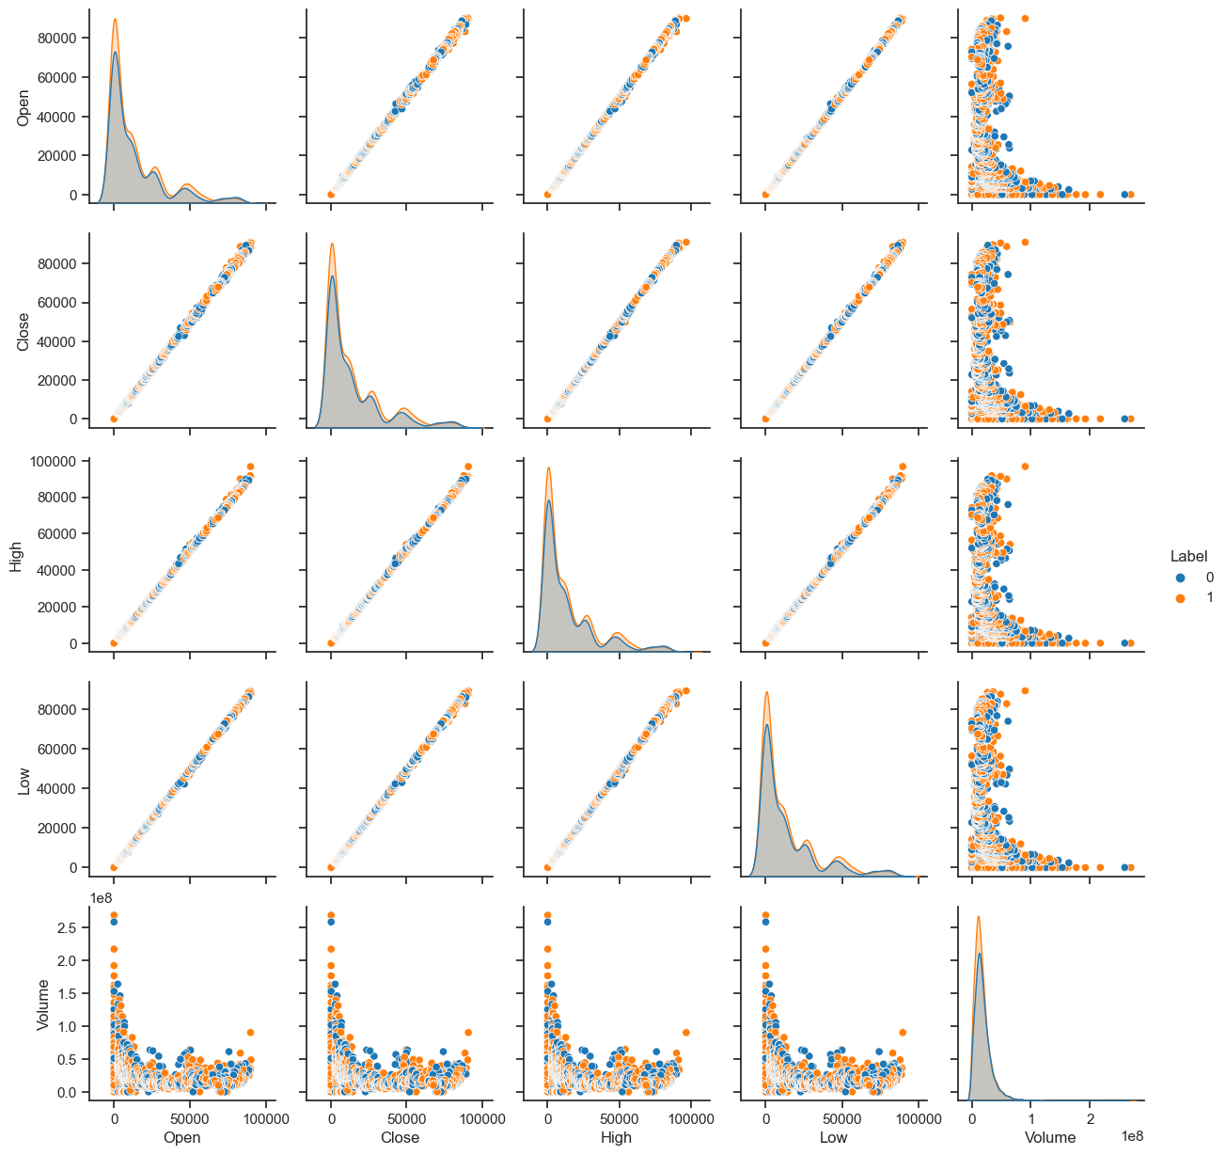
Data analysis

Slide 7
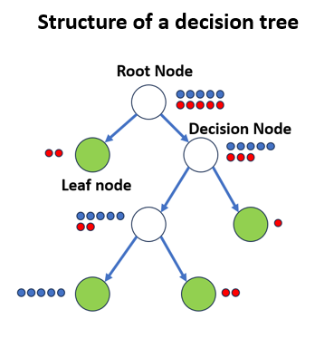
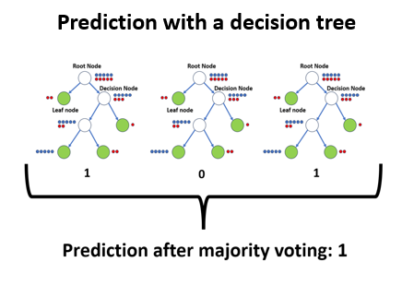
Funktion of the model

Slide 8
Concept of analysis and evaluation of the models

Slide 9
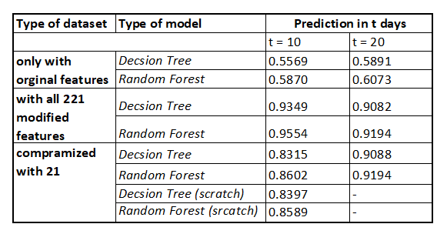
Results

Slide 10
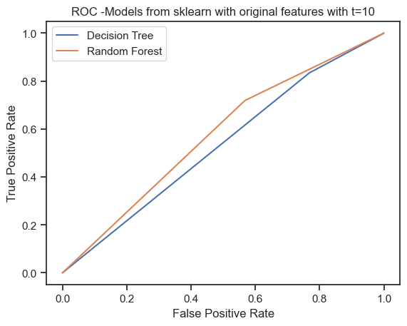
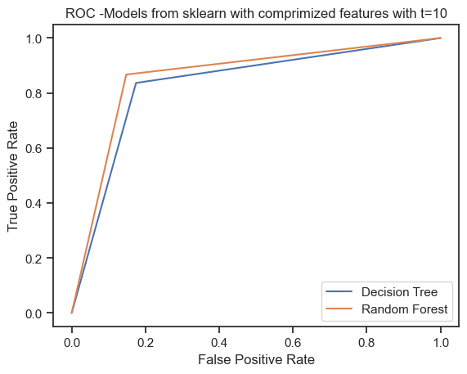
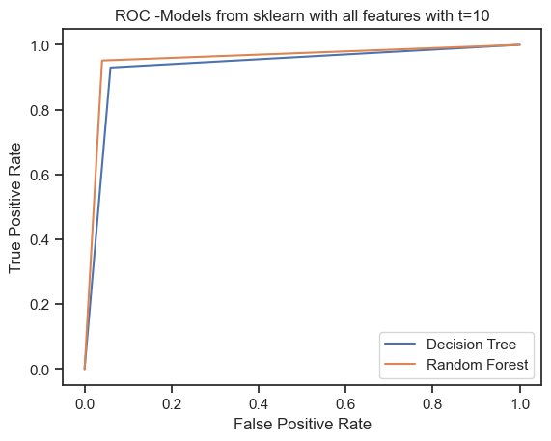
Results

Slide 11
Conclusion

Slide 12

Thank you for your attention! Do you have any questions?
https://dev.to/theinterviewsage/do-you-have-any-questions-for-me-facebook-behavioral-jedi-interview-series-1dpa

